Slide 1

Sun Watch
Elizabeth Liu

Slide 2
Idea
Overexposure to the sun’s ultraviolet rays is the most important preventable factor in the development of skin cancer. Skin cancer is largely preventable when sun protection measures against UV rays are used consistently. Sometimes it may be difficult for a person to remember to take preventive measures when they are outside. They may also be unaware when they should stay indoors/in the shade, especially under extreme UV rays. On the other hand, it is also important for people to get enough sun exposure to synthesize Vitamin D and stay healthy.
Wearable device that detects UV radiation intensity.

Slide 3
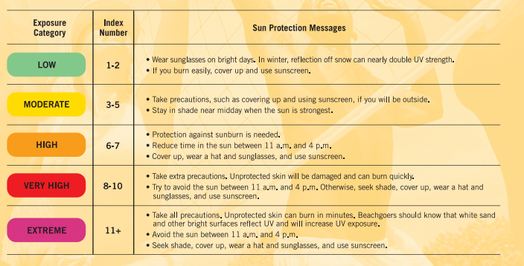
UV Index Chart

Slide 4
Interface
Electrical component:
UV sensor – UV photodiode detects UV wavelengths,
convert voltage to UV index by dividing the voltage by 0.1V.
Usability & Accessibility:
Left-hand, right-hand – no buttons on the side, home/exit button in the middle
Touch screen – swipe up, down, left, or right
Vibration – notifications and alerts
Zoom – use two finger to zoom in and out

Slide 5
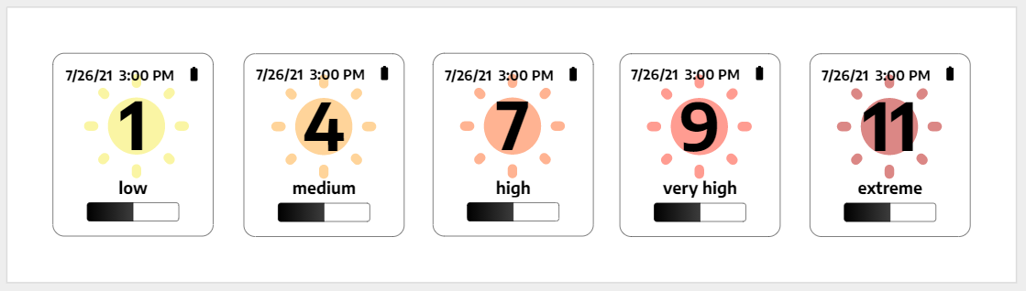
Interface
Progress Bar: 70 minutes of medium sunlight exposure per week (10 minutes per day)

Slide 6
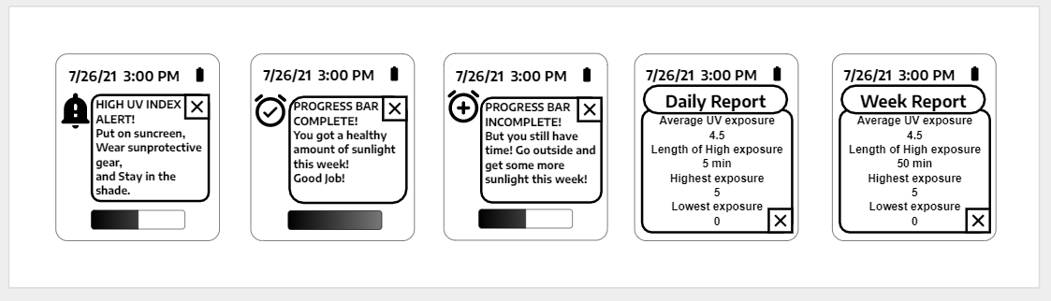
Interface
HIGH UV INDEX ALERTS:
High: vibrates one for 1s
Very High: vibrates twice in a row each 1s
Extreme: vibrates three times in a row each 1s
OTHER NOTFICATIONS: vibrates once quickly less than 1s

Slide 7
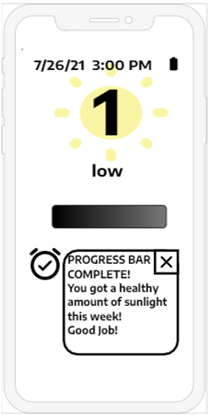
Interface
Bluetooth iPhone App: Sun Watch App
Bluetooth – gets UV data, notifications, etc., from the Sun Watch
Allows for more Accessibility:
App reads out the UV index, notifications, etc.
Bigger screen to view information on watch
Phone can also vibrate for notifications

Slide 8
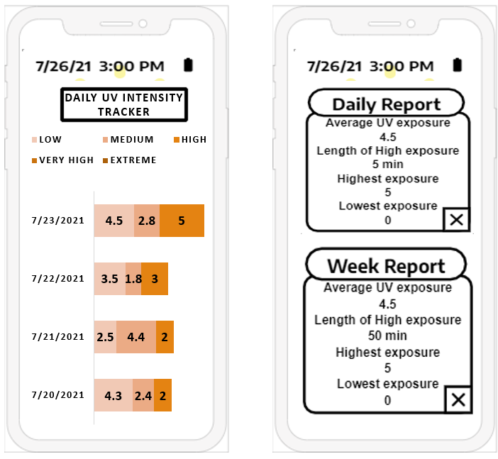
Interface
Other features of the app:
Daily UV Intensity Tracker
Tracks UV exposure over time, and the length of exposure to low, medium, high, very high, and extreme UV rays.
Daily and Weekly Reports

Slide 9
References
Fitbit Community. Accessibility for People with Visual Impairments (voice/audio). Fitbit Community. https://community.fitbit.com/t5/Feature-Suggestions/Accessibility-for-People-with-Visual-Impairments-voice-audio/idi-p/3528909. Community Posts.
Industries, Adafruit. “Analog UV Light Sensor Breakout - GUVA-S12SD.” Adafruit Industries Blog RSS, www.adafruit.com/product/1918.
Raman, Ryan. “How to Safely Get Vitamin D From The Sun.” Healthline, Healthline Media, 28 Apr. 2018, www.healthline.com/nutrition/vitamin-d-from-sun.
United States Environmental Protection Agency. A Guide to the UV Index, United States Environmental Protection Agency, 2004.

